Slide 1
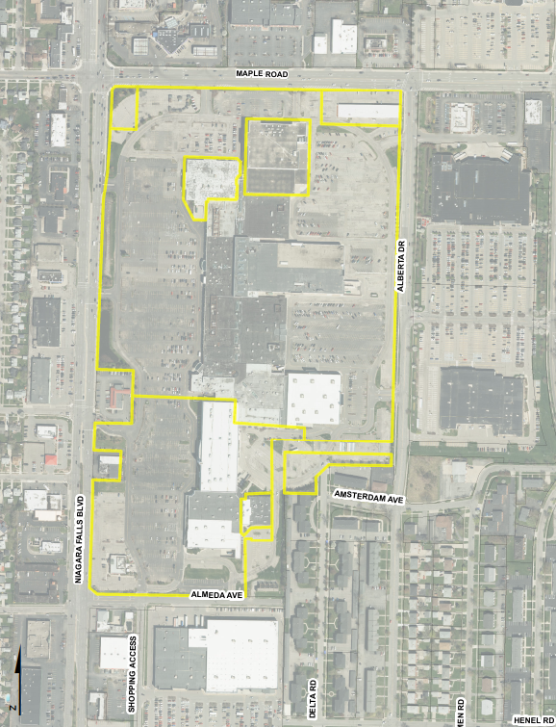

Boulevard Mall
Opened in 1962 as first indoor shopping center in WNY
Thrived as shopping destination for 40 years
Located near strong residential neighborhoods and UB North Campus
Access to major arterials
Town intervention to jumpstart redevelopment
Notes:
Larger BCD still retains a strong retail draw…
With the second highest density in all of WNY, the Boulevard District lies halfway between UB’s North and South Campuses

Slide 2
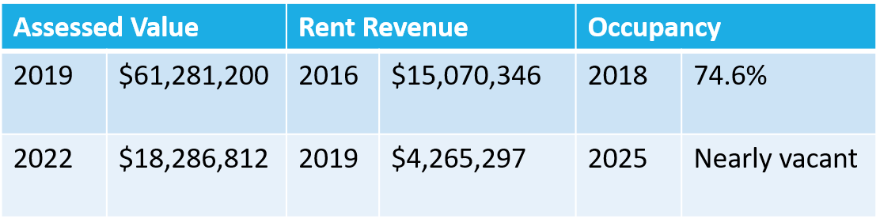
Decline of the Property
Began to experience downturn in 2010s with growth of online shopping, leading to closure and relocation of stores, including anchors
Currently nearly fully vacant and interior of Mall is shut down
Deteriorating physical conditions of buildings and empty parking lots
In 2018, Mall went into receivership and was purchased at auction by Douglas Development for $25M

Slide 3
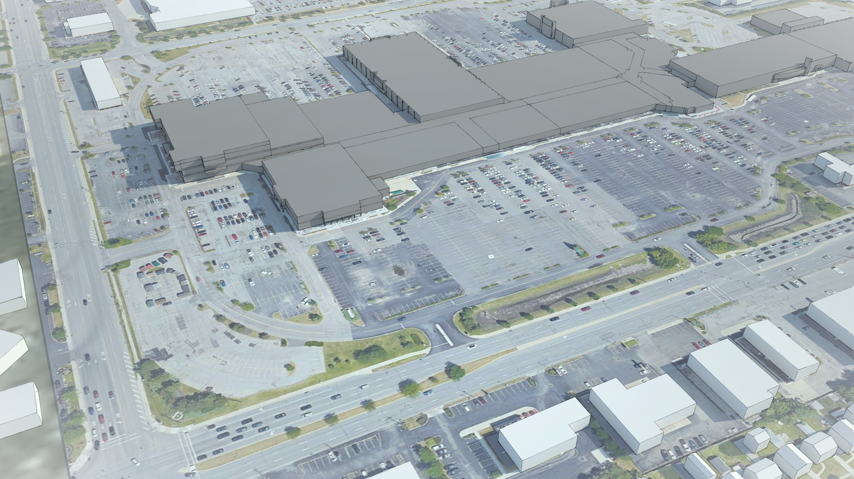
Redevelopment Objectives
Remove barriers to redevelopment – Eminent Domain, Rezoning, GEIS
1
Direct revitalization of site
2
Restore tax base and provide return on Town’s investment
3
Attract redevelopment and reinvestment
4
Notes:
The Mall has gone through many transformations, the most dramatic lies ahead….

Slide 4
Guiding Principals
Long-term, phased redevelopment of site (20+ years)
Integrated mix of land uses
Variety of housing options to address varied needs of Amherst residents
New roads to create block street pattern
Greenspace
Community center

Slide 5
Town of Amherst Involvement
2019 – Town actively engaging to redevelopment mall
  Adoption of Mixed-Use Zoning
  Generic Environment Impact Statement to facilitate redevelopment
  Creation of Boulevard Central District Action Plan
  Exploration of Eminent Domain to address legacy lease
Power of Eminent Domain
Public Infrastructure
Planning and Zoning
Partnership with NYS ($31M West Side Interceptor Grant)

Slide 6
Redevelopment Partners
Benderson Development
Proven track record of high-quality developments
WNY company – leadership is personally invested in success of the project and Amherst
Amherst IDA
Amherst Development Corporation
Unique tools in economic development toolkit
Power to establish PIF district and grant incentives to eligible projects
Sweet Home Central School District
Partner in PIF district
School District Office/Activities Onsite

Slide 7
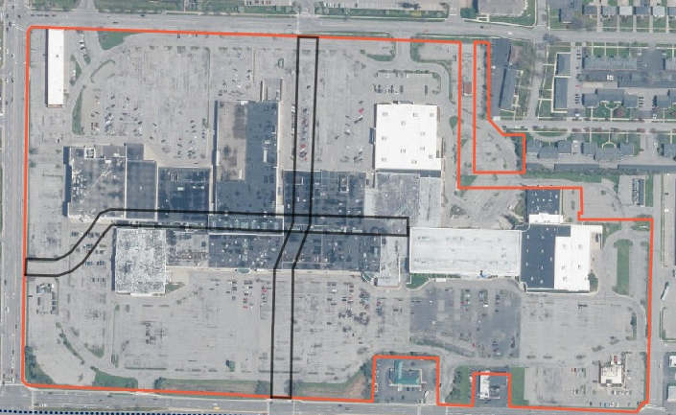
Demolition, Roads, and Infrastructure

Slide 8
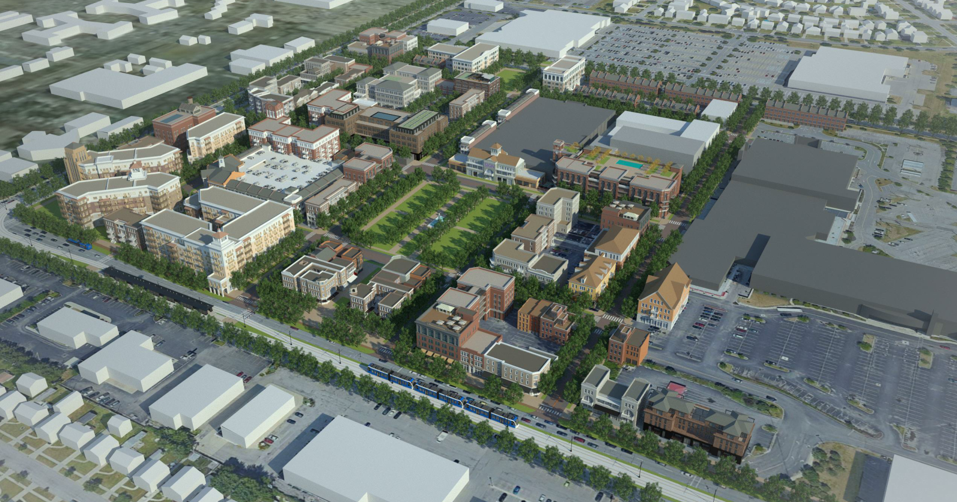
Vibrant Mixed-Use Development
Mixed-Use
Mixed-Income
Structured Parking
400 – 600 multi-family residential units

Slide 9
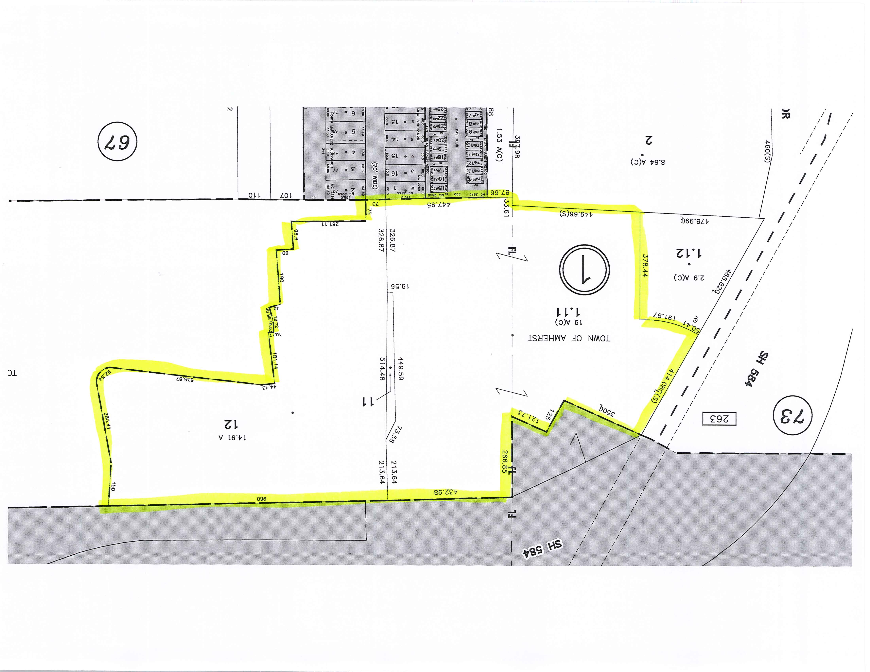
PILOT Increment Financing (PIF)
Applies to AIDA eligible projects in defined geographic zone
Modeled after Amherst Central Park/Northtown Center Project
  Taxing jurisdictions realize full revenues retail/restaurant revelopment
Revenues generated From Amherst Central Park PIF
  Northwest Community Center
  Park & Recreation Improvements
    Softball Diamonds and Northtown Center Complex

Slide 10
Financing Boulevard Mall Redevelopment
ITEM | ESTIMATED COST
Planning | $300,000
Surveys | $50,000
Environmental | $25,000
GEIS | $150,000
Legal / Eminent Domain | $400,000
Appraisals | $300,000
Acquisition Cost | $5,000,000
Community Center | $10,000,000
Roadway/Utility Infrastructure | $9,000,000
Park Development | $600,000
TOTAL: | ~$30,000,000
Public-Private-Partnership
Geography limited to Boulevard Mall Site
Direct new AIDA eligible PILOTs from projects on site to a fund
  Only applies to Amherst IDA eligible projects
PIF Funds pay for Town infrastructure and onsite expenditures
3(4)-Party Agreement allow for designation of PILOTs to a Fund to pay for agreed upon expenses
  20-year term
  Taxing jurisdictions receive 100% of new property taxes and special district charges on non-Amherst IDA projects
Draft agreements similar to Amherst Central Park PIF Agreements

Slide 11
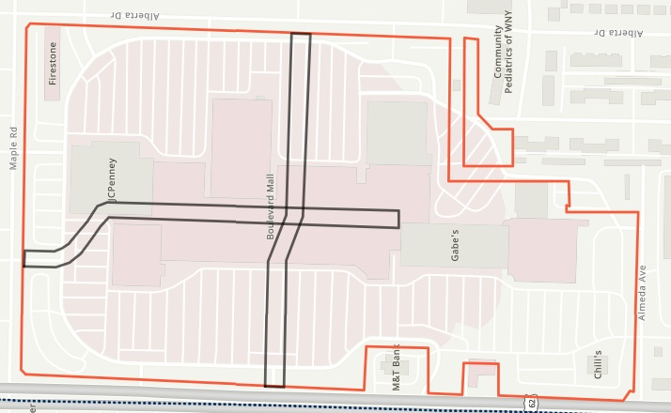
Modeled Tax Revenues – 20-Years
Mixed-Use Residential
Assessed Value $65 million at full build-out
Property tax revenues part of PIF over 20-years
Used to offset infrastructure/development costs
Conservative Development Forecast
Commercial Development
  Retail, Restaurant, Entertainment
Assessed Value $60 million at full build-out
Estimated $36 million property tax revenues over 20-years
Non-abated as if owned property

Slide 12
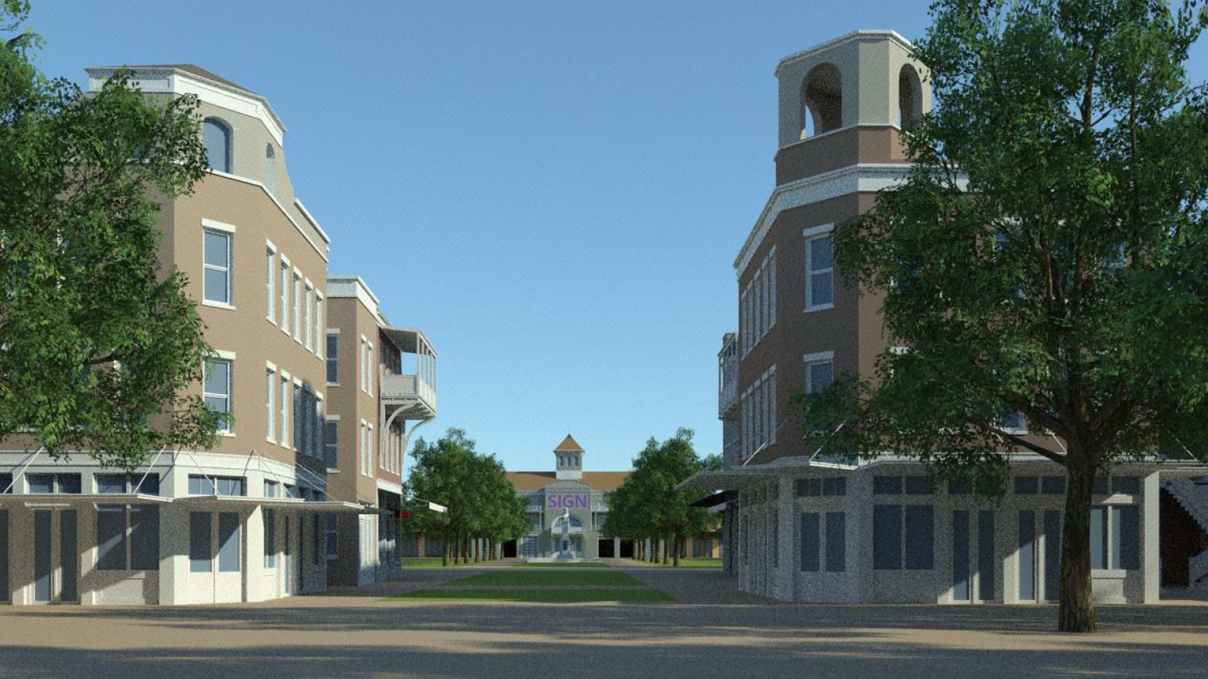

Successful Redevelopment
Phased reactivation of site as high-density, mixed-use development
Generation of long-term revenue to Town, school district and county
High quality commercial/retail development
Variety of housing to meet varied needs of Amherst residents
Community center with adjacent park

